Slide 1
Cryptography (2021 Fall) perfect secrecy, one-time pad
LiangFeng Zhang
zhanglf@shanghaitech.edu.cn
SIST, ShanghaiTech

Slide 2
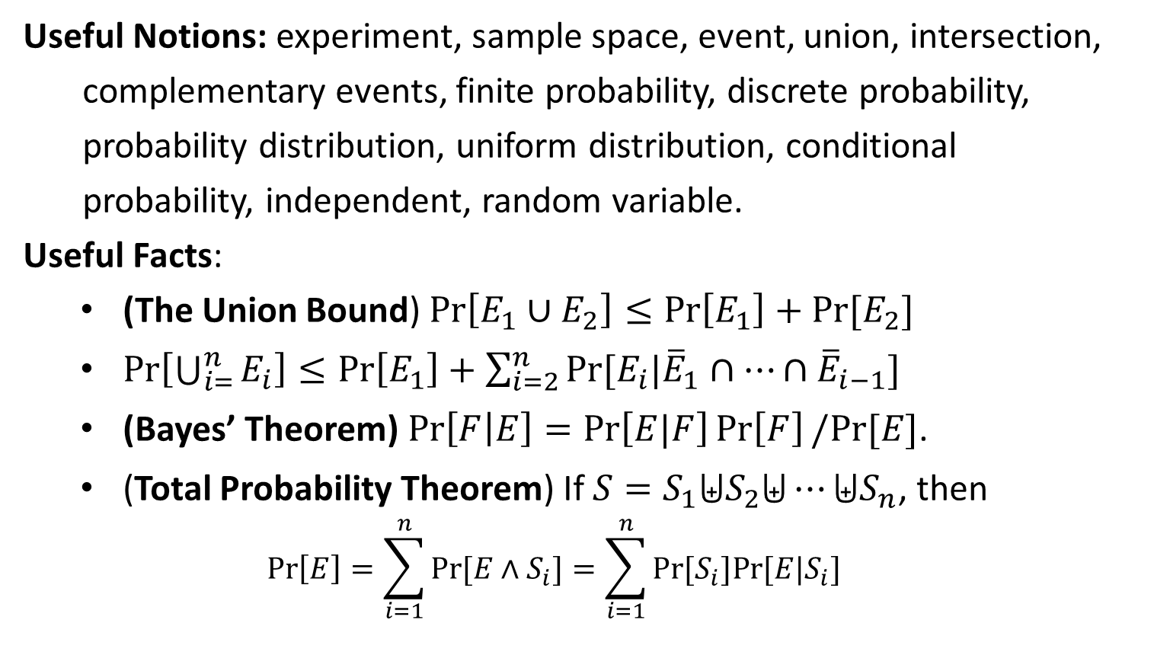
Probability
Useful Notions: experiment, sample space, event, union, intersection,
complementary events, finite probability, discrete probability,
probability distribution, uniform distribution, conditional
probability, independent, random variable.
Useful Facts:
(The Union Bound) $\operatorname{Pr}\left[E_{1}∪E_{2}\right]≤\operatorname{Pr}\left[E_{1}\right]+Pr⁡[E_{2}]$
$\operatorname{Pr}\left[\bigcup_{i=}^{n}{E_{i}}\right]≤\operatorname{Pr}\left[E_{1}\right]+\sum_{i=2}^{n}{Pr⁡[E_{i}|{\overline{E}}_{1}∩⋯∩{\overline{E}}_{i−1}]}$
(Bayes’ Theorem) $\operatorname{Pr}\left[F | E\right]=\operatorname{Pr}\left[E|F\right]\operatorname{Pr}\left[F\right]/Pr⁡[E]$.
(Total Probability Theorem) If $S=S_{1}⨄S_{2}⨄⋯⨄S_{n}$, then
$$\operatorname{Pr}\left[E\right]=\sum_{i=1}^{n}{Pr⁡[E∧S_{i}]}=\sum_{i=1}^{n}{Pr[S_{i}]Pr⁡[E|S_{i}]}$$

Slide 3


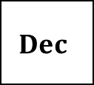


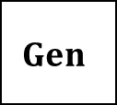

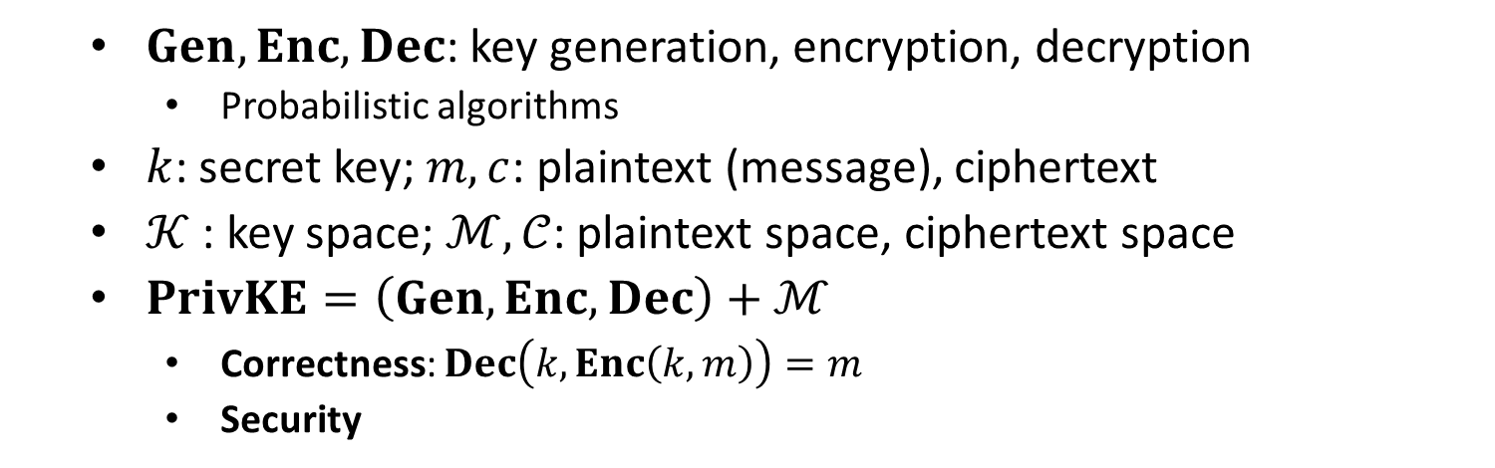
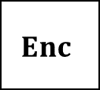


Private-Key Encryption (PrivKE)
$$m$$
$$Enc$$
$$Enc(k, m)=c$$
$$Dec$$
Alice
Bob
$$k$$
$$k$$
$$Dec(k, c)=m$$
$$Gen$$
$Gen, Enc, Dec$: key generation, encryption, decryption
Probabilistic algorithms
$k$: secret key; $m, c$: plaintext (message), ciphertext
$𝒦$ : key space; $ℳ,𝒞$: plaintext space, ciphertext space
$PrivKE=\left(Gen, Enc, Dec\right)+ℳ$
Correctness: $Dec\left(k,Enc\left(k,m\right)\right)=m$
Security

Slide 4
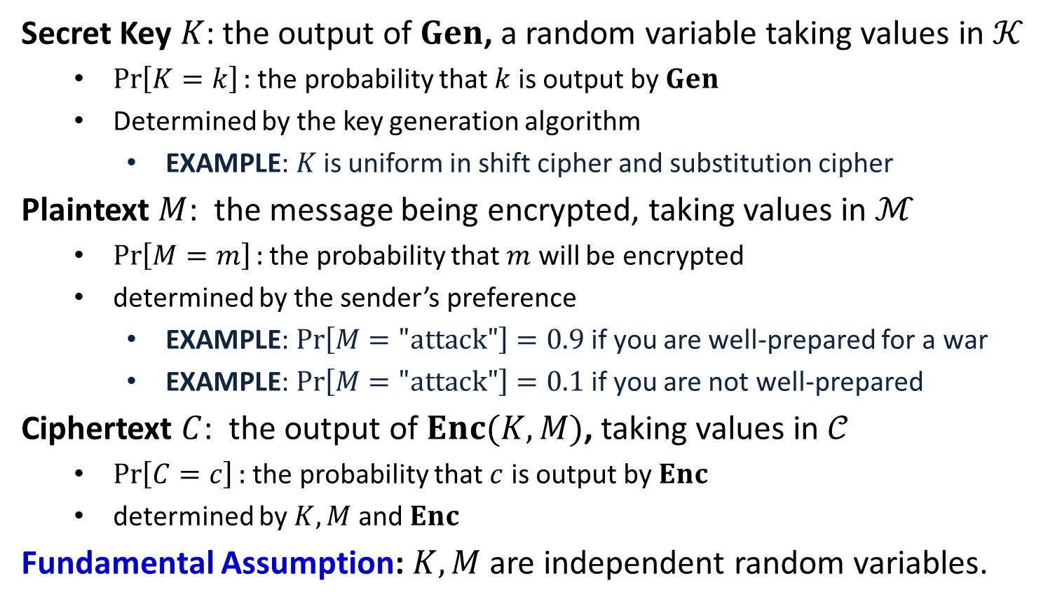
Distributions on $𝒦,ℳ,𝒞$
Secret Key $K$: the output of $Gen$, a random variable taking values in $𝒦$
$\operatorname{Pr}\left[K=k\right]:$ the probability that $k$ is output by $Gen$
Determined by the key generation algorithm
EXAMPLE: $K$ is uniform in shift cipher and substitution cipher
Plaintext $M$: the message being encrypted, taking values in $ℳ$
$\operatorname{Pr}\left[M=m\right]:$ the probability that $m$ will be encrypted
determined by the sender’s preference
EXAMPLE: $\operatorname{Pr}\left[M="\text{attack}"\right]=0.9$ if you are well-prepared for a war
EXAMPLE: $\operatorname{Pr}\left[M="\text{attack}"\right]=0.1$ if you are not well-prepared
Ciphertext $C$: the output of $Enc(K,M)$, taking values in $𝒞$
$\operatorname{Pr}\left[C=c\right]:$ the probability that $c$ is output by $Enc$
determined by $K,M$ and $Enc$
Fundamental Assumption: $K,M$ are independent random variables.

Slide 5
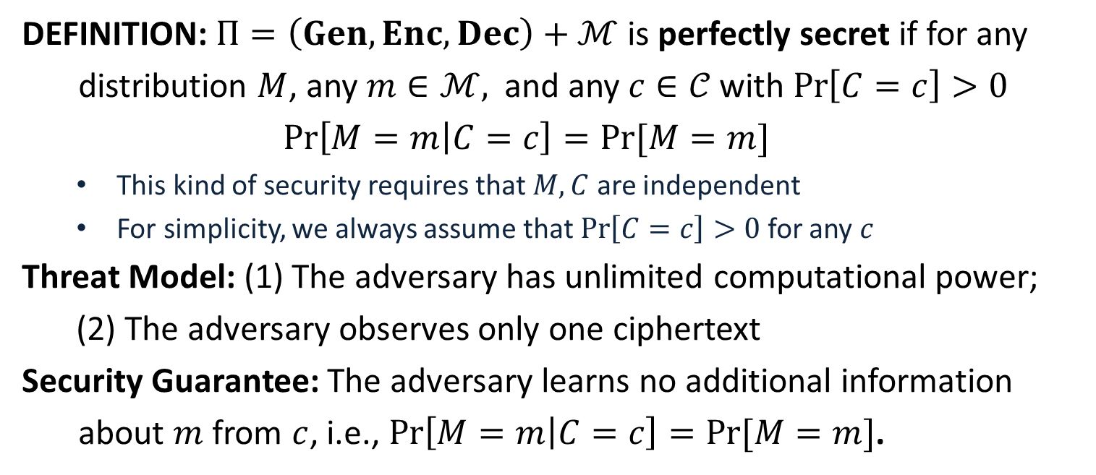
Perfect Secrecy
DEFINITION: $Π=\left(Gen, Enc, Dec\right)+ℳ$ is perfectly secret if for any
distribution $M$, any $m∈ℳ,$ and any $c∈𝒞$with $\operatorname{Pr}\left[C=c\right]>0$
$$\operatorname{Pr}\left[M=m | C=c\right]=Pr⁡[M=m]$$
This kind of security requires that $M,C$ are independent
For simplicity, we always assume that $\operatorname{Pr}\left[C=c\right]>0$ for any $c$
Threat Model: (1) The adversary has unlimited computational power;
(2) The adversary observes only one ciphertext
Security Guarantee: The adversary learns no additional information
about $m$ from $c$, i.e., $\operatorname{Pr}\left[M=m | C=c\right]=Pr⁡[M=m]$.

Slide 6
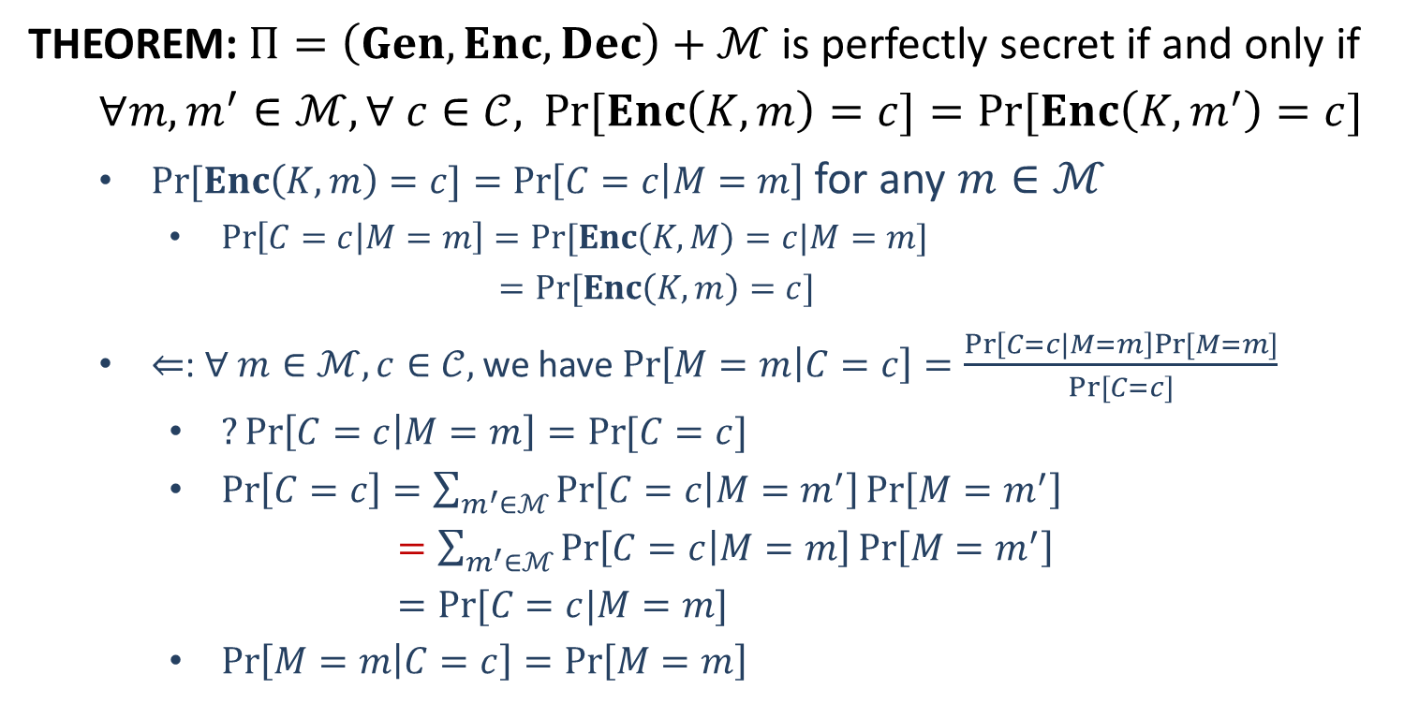
Perfect Secrecy
THEOREM: $Π=\left(Gen, Enc, Dec\right)+ℳ$ is perfectly secret if and only if
$∀m, m^{′}∈ℳ, ∀ c∈𝒞,$ $\operatorname{Pr}{[Enc\left(K,m\right)=c]}=Pr⁡[Enc\left(K,m^{′}\right)=c]$
$\operatorname{Pr}{[Enc\left(K,m\right)=c]}=\operatorname{Pr}\left[C=c | M=m\right]$ for any $m∈ℳ$
$\operatorname{Pr}\left[C=c | M=m\right]=Pr⁡[Enc\left(K,M\right)=c|M=m]$
$=Pr⁡[Enc\left(K,m\right)=c]$
$⇐$: $∀ m∈ℳ, c∈𝒞,$ we have $\operatorname{Pr}\left[M=m | C=c\right]=\frac{\operatorname{Pr}\left[C=c|M=m\right]Pr⁡[M=m]}{Pr⁡[C=c]}$
$?\operatorname{Pr}\left[C=c | M=m\right]=\operatorname{Pr}{[C=c]}$
$\operatorname{Pr}\left[C=c\right]=\sum_{m^{′}∈ℳ}{\operatorname{Pr}\left[C=c | M=m^{′}\right]\operatorname{Pr}\left[M=m^{′}\right]}$
$=\sum_{m^{′}∈ℳ}{\operatorname{Pr}\left[C=c | M=m\right]\operatorname{Pr}\left[M=m^{′}\right]}$
$=Pr⁡[C=c|M=m]$
$\operatorname{Pr}\left[M=m | C=c\right]=\operatorname{Pr}\left[M=m\right]$

Slide 7
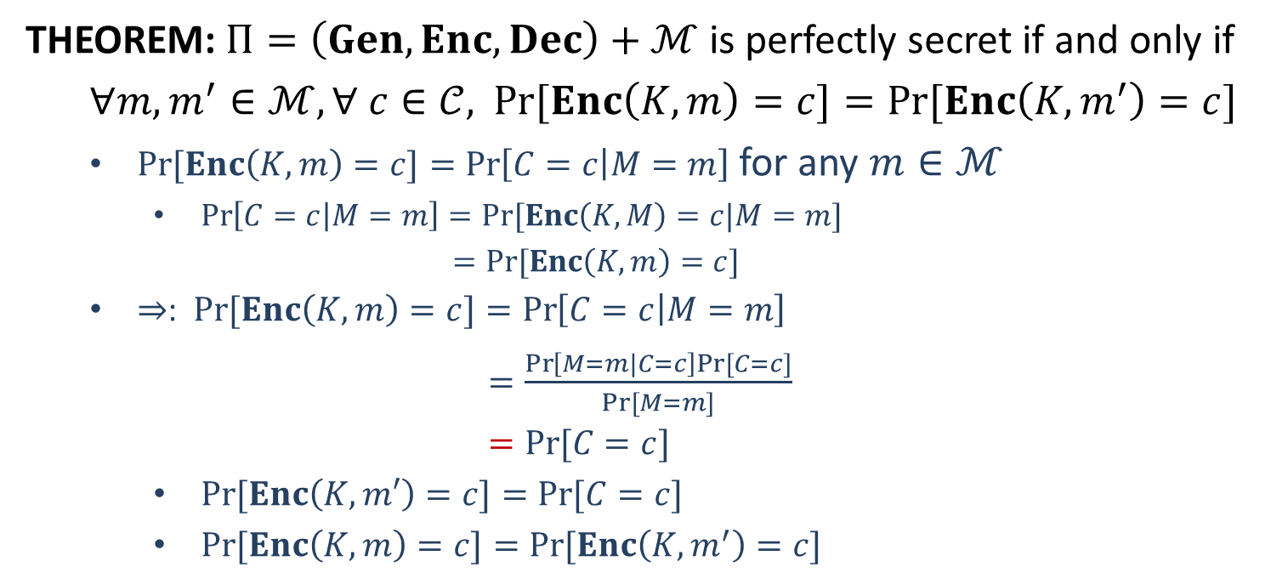
Perfect Secrecy
THEOREM: $Π=\left(Gen, Enc, Dec\right)+ℳ$ is perfectly secret if and only if
$∀m, m^{′}∈ℳ, ∀ c∈𝒞,$ $\operatorname{Pr}{[Enc\left(K,m\right)=c]}=Pr⁡[Enc\left(K,m^{′}\right)=c]$
$\operatorname{Pr}{[Enc\left(K,m\right)=c]}=\operatorname{Pr}\left[C=c | M=m\right]$ for any $m∈ℳ$
$\operatorname{Pr}\left[C=c | M=m\right]=Pr⁡[Enc\left(K,M\right)=c|M=m]$
$=Pr⁡[Enc\left(K,m\right)=c]$
$⇒$: $\operatorname{Pr}{[Enc\left(K,m\right)=c]}=\operatorname{Pr}\left[C=c | M=m\right]$
$=\frac{\operatorname{Pr}\left[M=m|C=c\right]Pr⁡[C=c]}{Pr⁡[M=m]}$
$=Pr⁡[C=c]$
$\operatorname{Pr}{[Enc\left(K,m′\right)=c]}=Pr⁡[C=c]$
$\operatorname{Pr}{[Enc\left(K,m\right)=c]}=Pr⁡[Enc\left(K,m^{′}\right)=c]$

Slide 9
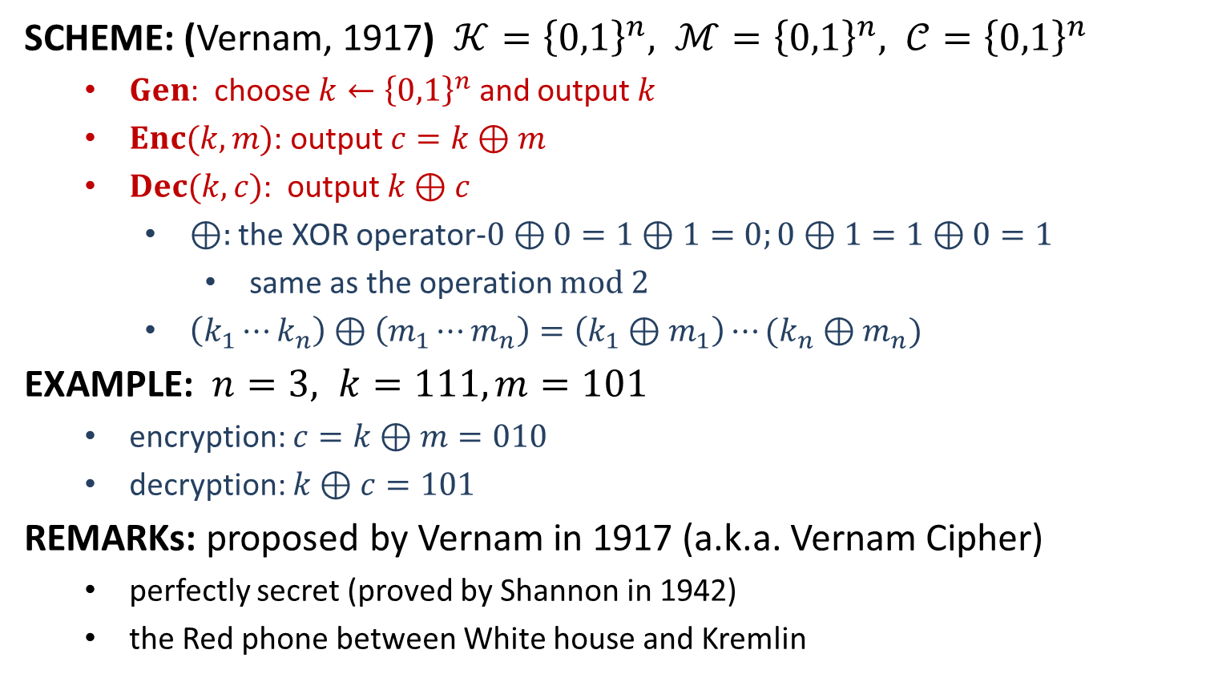
One-Time Pad
SCHEME: (Vernam, 1917) $𝒦={\left\{0,1\right\}}^{n}, ℳ={\left\{0,1\right\}}^{n}, 𝒞={\left\{0,1\right\}}^{n}$
$Gen$: choose $k←{\left\{0,1\right\}}^{n}$ and output $k$
$Enc(k,m)$: output $c=k⊕m$
$Dec(k,c)$: output $k⊕c$
$⊕:$ the XOR operator-$0⊕0=1⊕1=0;0⊕1=1⊕0=1$
same as the operation $mod 2$
$\left(k_{1}⋯k_{n}\right)⊕\left(m_{1}⋯m_{n}\right)=\left(k_{1}⊕m_{1}\right)⋯(k_{n}⊕m_{n})$
EXAMPLE: $n=3, k=111, m=101$
encryption: $c=k⊕m=010$
decryption: $k⊕c=101$
REMARKs: proposed by Vernam in 1917 (a.k.a. Vernam Cipher)
perfectly secret (proved by Shannon in 1942)
the Red phone between White house and Kremlin

Slide 10
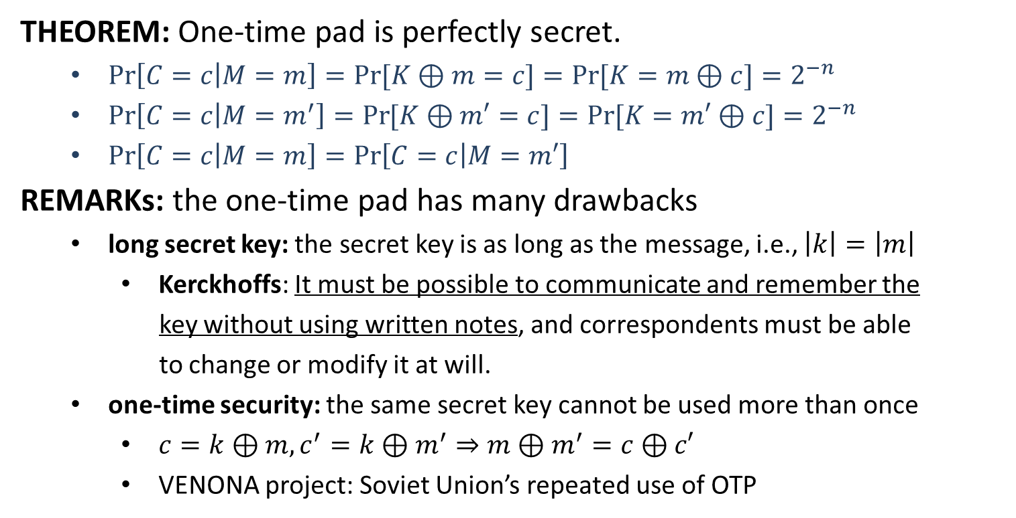
One-Time Pad
THEOREM: One-time pad is perfectly secret.
$\operatorname{Pr}\left[C=c | M=m\right]=\operatorname{Pr}{[K⊕m=c]}=Pr⁡[K=m⊕c]=2^{−n}$
$\operatorname{Pr}\left[C=c | M=m^{′}\right]=\operatorname{Pr}{[K⊕m′=c]}=Pr⁡[K=m′⊕c]=2^{−n}$
$\operatorname{Pr}\left[C=c | M=m\right]=\operatorname{Pr}\left[C=c | M=m′\right]$
REMARKs: the one-time pad has many drawbacks
long secret key: the secret key is as long as the message, i.e., $\left|k\right|=\left|m\right|$
Kerckhoffs: It must be possible to communicate and remember the
key without using written notes, and correspondents must be able
to change or modify it at will.
one-time security: the same secret key cannot be used more than once
$c=k⊕m, c^{′}=k⊕m^{′}⇒m⊕m^{′}=c⊕c′$
VENONA project: Soviet Union’s repeated use of OTP

